Slide 1
CSSSKL 342: Week 3
4/14/2023
Prof. Katie Ewing

Slide 2
Today’s topics
Lab 2 review & learnings
Header files
Classes
Constructors & Destructors
Inheritance
Exceptions
Scope and lifespan
Work on Lab 3

Slide 3
Exercise 1: Pointer manipulation
It is confusing to declare 2 pointers in one line
int* aPtr, bPtr; //Pitfall: note that bPtr is an int, not an int *
int* aPtr, * bPtr; //Now they’re both int *
A pointer is a memory address. Dereference it to get the value at that address
cout << "\"aPtr\" is a pointer, whose value is " << aPtr << endl;
cout << "\"aPtr\" points to the following value: " << *aPtr << endl;

Slide 4
display1() v. display2()
void display1(int l, int m, int n, int o, int* p)
void display2(int l, int m, int n, int o, int& p)
int a = 3;
int* aPtr, bPtr;
aPtr = &a;
display2(a, b, c, d, bPtr);
display2(a, b, c, d, a);
display2(a, b, c, d, *aPtr;

Slide 5
Exercise 2: function pointers
Function pointers allow you to pass a function like it is an object
typedef double (*functionType)(double x);
void displayFVal(functionType f, double input)
{
cout << "f(" << input << ") = " << f(input) << endl;
}
Most compilers will let you do this:
cout << getValue << endl;

Slide 6
Exercise 3: dynamic memory allocation
What happens when you allocate an array of size 0?
What happens when you allocate an array with negative size?
What is a bad malloc?
Once you delete (free) some memory, it is available to use again
But it is a new variable and new pointer pointing to it!
Every new should be paired with a delete
You can run valgrind to test if your program has any leaks

Slide 7
Best practices
A best practice is a pattern or a habit that can prevent mistakes or help make mistakes more obvious
Best practices are not enforced by the program and do not make a difference to the execution of the program - they are for humans!
Best practices are developed over time as a solution to common errors

Slide 8
The memory allocator
Under the hood, something called the memory allocator is implementing the functions malloc and free
These are C concepts
You can also use malloc and free directly, but it will only allocate/free the memory, it will not do anything else in the constructor / destructor
When you get a “bad_alloc” error, that means the allocator tried to give you memory but could not for some reason
This is a very serious class of bug! A bad_alloc is the least dangerous outcome
There are many different implementations of memory allocators, but the one we are using is the one in glibc
Sources: https://sourceware.org/glibc/wiki/MallocInternals, https://www.geeksforgeeks.org/dynamic-memory-allocation-in-c-using-malloc-calloc-free-and-realloc/

Slide 9
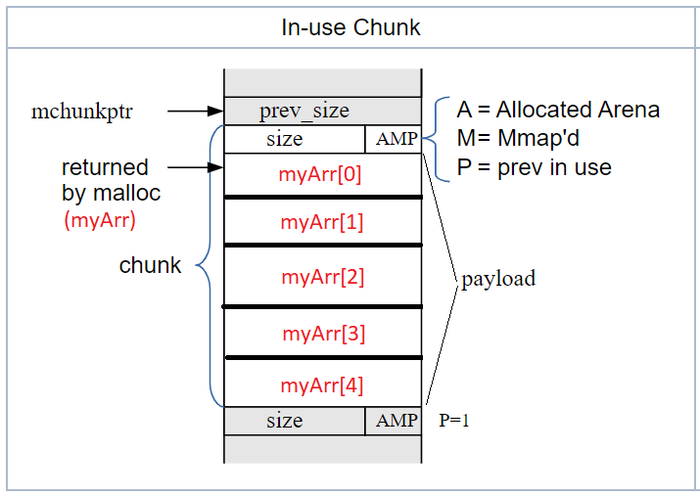
An allocated chunk (glibc specific)
The payload is the array that you allocated using new
The pointer from the allocation points to the memory at the beginning of the payload
The chunk also keeps its size and some metadata about where it is and its neighbors
int* myArr = new int[5];

Slide 10
How to allocate, how to free (glibc specific)
The memory allocator keeps track of unused memory chunks in “bins”
For small chunks (like what you’d use to allocate an int), there are size-specific bins. These are singly linked lists, since all chunks are the same size, any chunk will do.
This is why you got the same memory address in Exercise 3 #5
Small bins are divided into “fastbin” and regular bins as a speed optimization
Before small chunks are added to the regular bin, they are coalesced if possible (and upgraded to large bin if necessary)
For larger chunks, different size chunks are stored in the same bin as a doubly-linked list. Then the allocator gives you the first chunk that’s large enough.
When a chunk is deallocated, it goes into an unsorted bin that will later be sorted into the other bins

Slide 11
Memory addresses
Memory addresses are written in hexadecimal (base 16) - that is why the numbers are a mix of letters and numbers (i.e. a = 11, b = 12…)
The collection of memory addresses form what is called the address space
Typically, old systems had 32 bit addressability but new systems have 64 bit addressability
On a 32 bit system, 2^32 addresses (4,294,967,296 bytes or 4 GiB)
On a 64 bit system, 2^64 addresses (18,446,744,073,709,551,615 bytes or 16 EiB)
Your system won’t have as much memory available as a 64-bit address space could use, so it uses a virtual address space
Many memory allocators will let the heap use as much space as the system provides - but it will affect other programs if you use too much

Slide 12
Exercise 4: swap
void mySwap(int* ptr1, int* ptr2) {
int temp = *ptr1;
*ptr1 = *ptr2;
*ptr2 = temp;
}
What happens if instead you do this?
int* tempPtr;
*tempPtr = *ptr1;
*ptr1 = *ptr2;
*ptr2 = *tempPtr;
What happens if instead you do this?
int* tempPtr = ptr1;
ptr1 = ptr2;
ptr2 = tempPtr;

Slide 13
Exercise 4: Linear search
int myLinearSearch(int data[], int size, int target){
int foundIndex = -1;
for (int i=0; i < size; i++){
if (data[i] == target){
return i;
}
}
return -1;
}

Slide 14
Exercise 4: Bubble sort
void bubble(int startPtr[], int size) {
for(int i = 0; i < size; i++) {
for(int k = 0; k < size - 1 - i; k++) {
if(*(startPtr + k) < *(startPtr + k+1)) {
mySwap(startPtr + k, startPtr + k + 1);
}
}
}
}

Slide 15
Pointer math vs array notation
To the computer, they are exactly the same!
When you are using ‘int []’ you are passing a pointer to the beginning of the array
Important: there is no copy when you pass the array! It is just the pointer to memory
Ultimately the choice is a matter of preference
You should use the same notation throughout a program
Many style guides will mandate one
I personally prefer the array notation. I find it easier to think about arrays than pointers

Slide 16
Readability
What makes code readable?
Adherence to style and convention
Naming
White space and formatting
Modularity
Complexity
Comments
Why is it important?
Debugging
Modifying your code later
Working with others

Slide 17
Multiple files
As your programs get longer and more complex, it can make sense to break up your code into different files
You will still have exactly one main() function per program. That means all other files will NOT have a main() function. The labs refer to the file with the main() function in it as the driver file
In order to use the code from other files, you will need to #include them, using their file name (and relative file path), and double quotes instead of angle brackets
#include “library.h”

Slide 18
Header files
When you have many functions calling other functions, it gets tricky to keep them in the correct order in a single file.
Header files are a solution to this
A header file has the file extension “.h”, and you can import it to any other file using #include “HeaderFileName.h”
Inside of a header file, you typically include only the function signature - not the body of the function
There are some exceptions, including templated functions. These are more advanced and we won’t cover them in detail in this course
The full function definition can be in your main.cpp file (allowed to be below main(), now!) or in another .cpp file, like Library.cpp

Slide 19
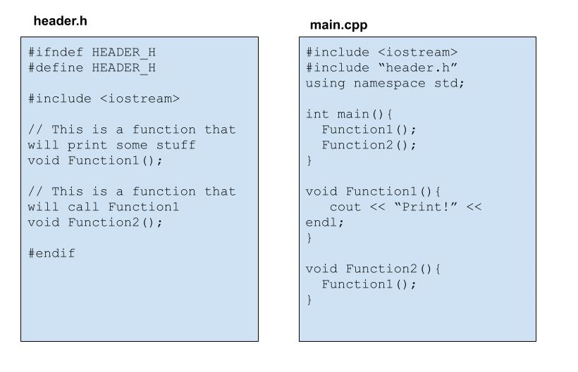
Header Files
Header files have the “.h” extension, code files have the “.cpp” extension
You need to include the header file into any code file that will use the functions declared there
If a header file gets included more than once, compilation will fail due to duplicate names. Protect against this by using include guards
Only use using namespace in code files

Slide 20
Include guards
C++ preprocessing is basic - it just takes the content of the file and copies it
If you include the file twice, it will copy twice! This won’t work because you try to redefine the same things
This is hard to catch when the file is included from different sources
So, we use preprocessor directives to tell the preprocessor to only load the file if it hasn’t been loaded before
#ifndef A_H
#define A_H
class A
{
// defined here
};
#endif
#pragma once
class A
{
// defined here
};

Slide 21
Multiple code files
We’ve seen how to put function signatures into a header file and keep the function definitions in main.cpp
You can also put the function definitions in a separate code file - typically using the .cpp file extension
You must import the header file into every code file that will use the functions - including the code file that contains the function definitions
library.h
library.cpp
main.cpp
void Func1();
#include “library.h”
void Func1(){
// do stuff
}
#include “library.h”
main(){
Func1();
}

Slide 22
Compiling with multiple files
To compile an executable with multiple code files (.cpp files) you must link them
Header files will be included as part of the preprocessing step as long as they are included into a .cpp file that is compiled
To compile and link File2.cpp, File2.cpp and File3.cpp
g++ File1.cpp File2.cpp File3.cpp
To compile and link all .cpp files in the current directory
g++ *.cpp

Slide 23
Header files and Code files - best practices
Header files should use the .h extension, code files should use the .cpp extension
Header files should generally not have code, with a few exceptions (like templates)
Header files should have include guards to prevent duplication
Only code files should use “using namespace …” - if it appears in a header file, it can “pollute” the namespace by unintentionally adding a namespace to any file that includes the header
Global variables should go in code files

Slide 24
What is a class?
A class is the definition of an object
A class has a name, data members, and member functions
The name is how an object of the class is created, used and identified. This is the type name of an object
The data members are information that the class stores about itself. For example, a string class might store its own length as a piece of data
The member functions are what a class does. For example, a string class might have an append() function to add to the string

Slide 25
Class definition
Class definitions begin with the keyword class, followed by the name of the class
The definition of the class is inside curly braces {} and ends with a semicolon (this is easy to miss!)
If you want to access your members outside of the class, set them to public, using the public keyword
Define each data member you want to use, in this case Name and Age;
In file Person.h:
class Person {
public:
std::string Name;
int Age;
};

Slide 26
Using a class
In file main.cpp:
int main() {
Person p1 = Person();
p1.Name = "Dan";
p1.Age = 51;
cout << "Person's name is: " << p1.Name << endl;
cout << "And their age is: " << p1.Age << endl;
}
Once a class has been defined you can make objects of that type (in the example, p1 is the object)
Each public member of the class can be accessed using the dot operator (.)

Slide 27
Public v Private
Public members and functions can be accessed from outside the class
Private members and functions can only be accessed from within the class
Private functions can be used to implement details that you do not need or want exposed
Generally, data members should be kept private, and should be accessed via getters and setters

Slide 28
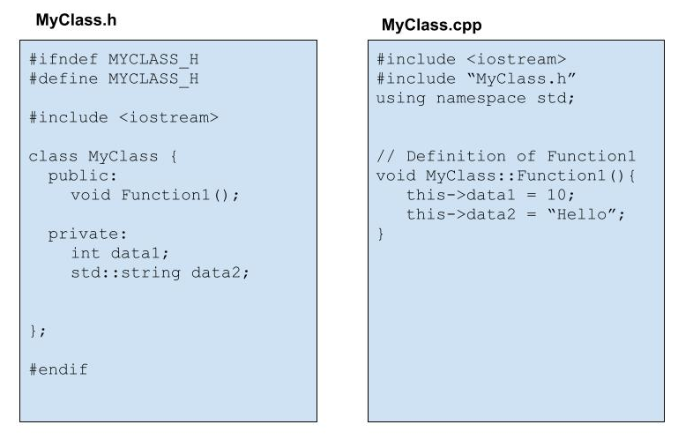
Header Files with Classes
It is common practice to give each class its own set of files. The header and code file should be named after the class
The class definition goes into the header file
Member functions are declared within the class definition
The definitions of the functions go into the code file. The function name is given with the class scope
(*this).data1

Slide 29
Member functions
In Person.h:
class Person {
void Print();
};
In Person.cpp:
void Person::Print(){
cout << Name << ", " << Age << endl;
}
In Main.cpp:
p1.Print();
Member functions are functions that are defined within the class.
Just like data members, member functions can be accessed from outside the class using the dot operator (.)
For example, string.length() is a member function of the string class
Function signatures go in the class definition in the header file (Class.h), Function definitions typically go in the cpp file (Class.cpp)
A function definition is associated with the class by using the scope (::) operator

Slide 30
Class Constructor
A constructor is a function that creates a new object
All types other than the built-in fundamental types have constructors
A constructor that takes no arguments is the default constructor
A constructor is called when the object is declared - if no arguments are given, the default constructor is used
Person p1 = Person(); // This calls the default constructor for Person class
Person p2; // This also calls the default constructor for Person class

Slide 31
Constructor definition
The compiler automatically creates a default constructor that creates an object with the default values for each of its member types
You can also define constructors, both the default constructor and other constructors with arguments
The constructor definition has the same name as the class and has no return type
Person(){
Name = "Janet";
Age = 99;
}
Person(string name){
Name = name;
}

Slide 32
Initialization list in constructors
It is very common to initialize data members inside of the constructor
C++ provides another syntax for initializing data members - the initialization list
Using the initialization list avoids a call to the default constructor (constructor with no arguments) when one is not necessary
One case where using the initialization list is required, is if you are defining a child class constructor that needs to create the parent class with a non-default constructor
For more details on cases where initialization lists are necessary, see https://www.geeksforgeeks.org/when-do-we-use-initializer-list-in-c/

Slide 33
Destructors
Classes have a special function called a destructor that is called when an object is destroyed (either explicitly through the delete keyword or when the object goes out of scope)
Destructors use the special name ~ClassName() - for example if your class is named MyClass, your destructor is named ~MyClass()
class Data{
public:
~Data();
};
Data::~Data(){
}

Slide 34
Destructors
Just like the compiler creates a simple constructor if you don’t define one, the compiler creates a simple destructor. In most cases you won’t need to define a destructor. The exception is if your class is using dynamic memory on the heap - aka the new keyword. Then a destructor is mandatory so that you may delete the memory you’ve allocated.
class Data{
public:
Data();
~Data();
private:
int* myHeapInt;
};
Data::Data(){
myHeapInt = new int;
}
Data::~Data(){
delete myHeapInt;
}

Slide 35
Example: Initialization list
Class definition, in Person.h:
class Person {
public:
Person();
Person(std::string name, int age);
private:
std::string Name;
int Age;
};
Constructor definitions, in Person.cpp:
Person::Person(): Name(“Janet”), Age(99){
// Nothing else to do
}
Person::Person(string input_name, int input_age)
: Name(input_name), Age(input_age) {
// Nothing else to do
}

Slide 36
Getters / Setters
Getters and setters are public functions that allow some access to the class’s data members
Getters ‘get’ the value of the member, setters ‘set’ the value of the member
In Person.h:
class Person{
public:
std::string GetName();
void SetName(std::string name);
private:
std::string name;
};
In Person.cpp:
string Person::GetName(){
return name;
}
void Person::SetName(string setName){
name = setName;
}

Slide 37
Accessing data members using ‘this’ implicit parameter
Inside of a class member function, you can access the class object itself by using ‘this’
‘this’ is implemented as a pointer to the object itself
For an object, you use the dot (.) operator to access a data member - for a pointer to an object, you use the arrow (->) operator
void Person::Print(){
cout << this->Name << “, “ << this->Age << endl;
// cout << (*this.)Name << “, “ << Age << endl;
// exactly the same as below
// cout << Name << “, “ << Age << endl;
}

Slide 38
Inheritance
Animal
void Feed();
double age;
C++ allows classes to inherit from other classes
A class that inherits from another class is called a sub-class or child class
The class that is inherited from is called a base class or parent class
Pet
void PlayWith();
string owner;
Wild Animal
void Tag();
string habitat;
Dog
void Walk();
bool hasFleas;
Fish
void CleanTank();
class Pet {
};
class Dog: public Pet{
};

Slide 39
Public / protected / private members
Public members are accessible to everybody, within or outside the class
Private members are accessible only inside the class itself
Protected members not accessible outside of the class, but they are accessible to the class itself and any class that inherits from it
class MyClass{
public:
int dataA;
protected:
int dataB;
private:
int dataC;
};

Slide 40
Public / protected / private inheritance
When the inherited class is declared, it can be declared with public, protected or private inheritance.
Member access is determined by the more conservative of the inheritance and access specifier within the base class
That is, if the inheritance is protected, the public members of the base class will become protected
If the inheritance is private, the public and protected members of the base class will become private.
If no inheritance keyword is used, private inheritance is used

Slide 41
Compile-time polymorphism
A child class is a subtype of the parent class. That is, something that is a Pet is also an Animal.
The same does not work in reverse, that is, a Animal does not need to be a Pet, so a generic Animal cannot be used as a Pet.
A Pet can be treated as a Pet or an Animal. But if you declare it to be an Animal, you will no longer be able to do Pet specific things.

Slide 42
Abstract classes
Sometimes you want to make a category of classes, but the category itself should not be an object
The classic example of this is Shapes: there are many different shapes, like Circle, and Square, and they share many attributes, like you can calculate area, or draw the shape. But you can’t do any of these things with a generic “Shape”
An abstract class is implemented by defining a pure virtual function, a function that does not have a definition, in the base class
An abstract class is also called an interface. Interfaces are common software patterns and many languages have ways to implement interfaces.

Slide 43
Abstract classes
class Shape {
virtual double CalculateArea() = 0;
};
class Triangle : public Shape {
public:
double CalculateArea() override;
private:
double height = 1;
double width = 1;
};
double Triangle::CalculateArea(){
return 0.5*height*width;
}
A pure virtual function is declared with the virtual keyword and the function = 0
If even one of the classes’s functions is a pure virtual function, the entire class is abstract
You cannot make an object of an abstract type

Slide 44
Overloading
Overloading means to use the same function with different parameters
The compiler will choose the best one - it will convert types if it needs to
When the compiler can’t choose - you will see output showing what it considered
Overloaded constructor:
A::A(){}
A::A(string name) : n(name){}
A myA1 = A();
A myA2 = A(“name”);
Overloaded (regular) function:
int add(int a, int b) { // stuff }
double add(double a, double b) { // stuff }
int x = add(4, 5);
double y = add(4.5, 6.5);

Slide 45
Exceptions: throw, try & catch
When the program encounters something it can’t handle, it can ‘throw’ an exception: throw std::invalid_argument("Invalid input");
If the exception is not caught, the program will end
Your program can “fail gracefully” by ‘trying’ something that could fail and ‘catching’ the exception and handling it
}
try {
myA.setValue(-100, 5);
}
catch (const std::exception &e) {
cout << "Caught exception: " << e.what() << endl;
}

Slide 46
Variable scope
A variable is only valid when it is within scope, from declaration until the close brace ‘}’ of a code block
Nested blocks can access variables from outer blocks
A function’s arguments are within the scope of the function
This is how to allow variables to be accessed from different scopes
// x doesn't exist
int x; // x is declared
{
// x can be used here
// y doesn't exist
int y; // y is declared
// y exists
} // y goes out of scope
// x can be used here
// y cannot be used here
}

Slide 47
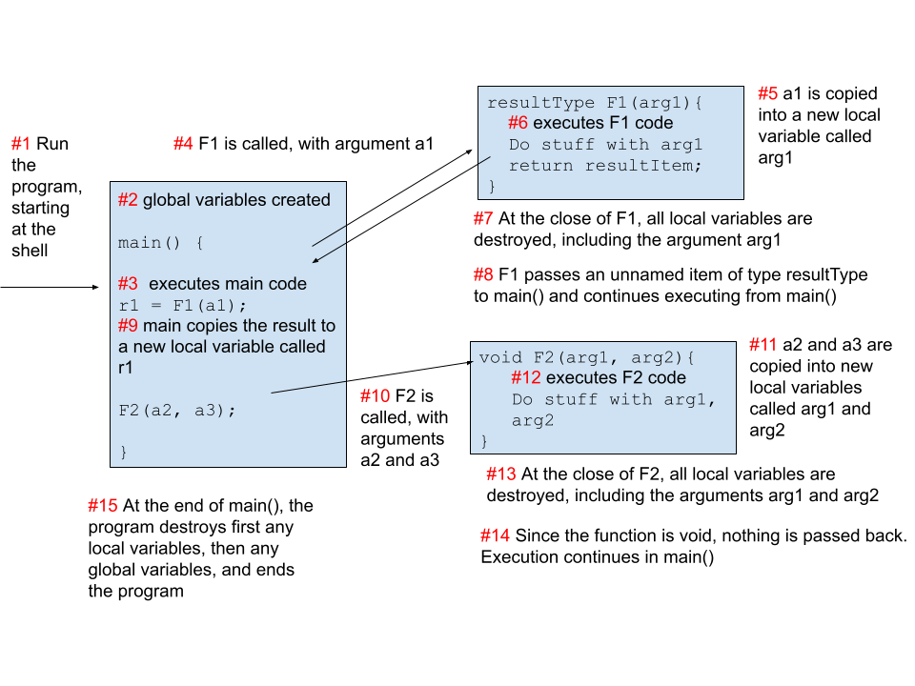
Functions - what happens?

Slide 48
Function stack
A stack is a data structure, where the last item added is the first one taken out. The analogy is a stack of plates – you always set new plates on the top of the pile, and also take a plate off the top of the pile. You will only reach the bottom plate if you first use all the plates above it.
Functions are called in a stack. The first function into the stack is the main() function. When you call a function F1(), F1() is added to the function stack. If F1() calls F2(), F2() will also be added to the stack, “atop” F1(). When F2() completes, it will be removed from the stack, and the execution will go back to F1(). When F1() completes, F1() is removed, and the execution will go back to main().

Slide 49
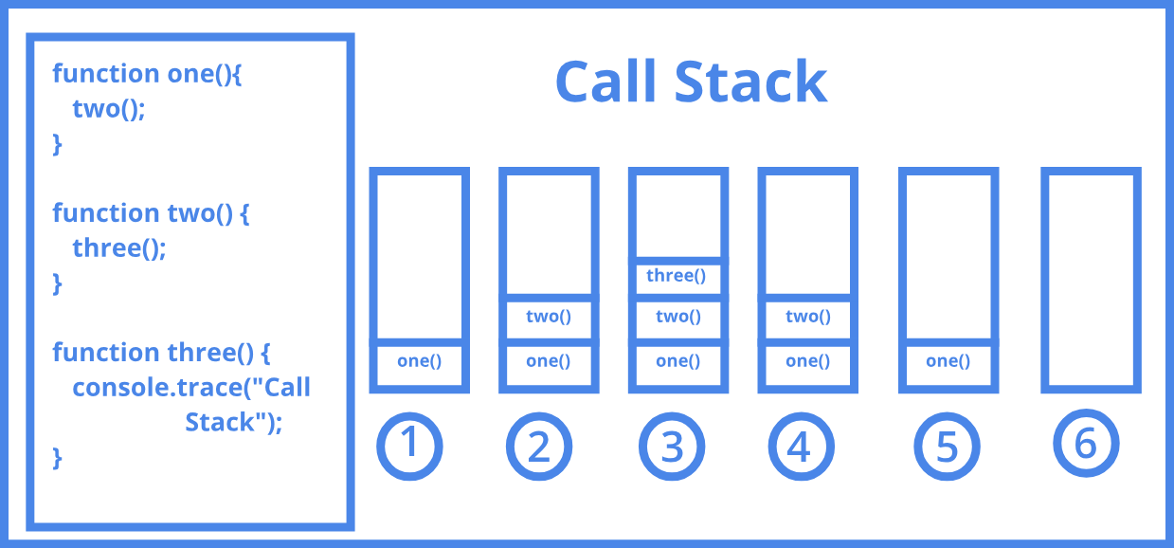
Function stack

Slide 50
static
A static variable exists from declaration until then end of the program - it does not get deleted when it goes out of scope!
Classes can have static member types - but all instances of a class share the same data member
Likewise, a static member function applies to the class itself, not the individual instance of the class
You can call as MyClass.staticFunction() or myObjectOfTypeClass.staticFunction()
Static functions can only use static data members

Slide 51
const keyword
The const keyword is short for constant, and it makes something immutable (that is, unable to be changed)
A const variable is a variable that can only be initialized, and never changed. A const variable is also called simply a constant.
The const keyword can go 3 different places in a function signature, each one indicating something different
Before the function name, this will make the return value const
After the function name, this will make the function const. The function cannot change any of the classes’ data members
In the argument list, this will make the argument const. The function cannot change the argument value.

Slide 52
lvalue & rvalue
Loosely, the “left” and “right” values in an assignment
int x = 4; //x is the lvalue, 4 is the rvalue
Only lvalues can be assigned to
lvalues can often be cast implicitly to a rvalue
int y = x; //x is an lvalue, cast to the rvalue of 4
lvalues exist in a specific place in memory
rvalues are temporary when used
Anything that is an lvalue can be assigned to
int& sum(int a, int b){
return this.sum + a + b;
}
myClass.sum() = 10;

